Slide 1
SQL - Transactions

Slide 2
Agenda
What is a transaction?
Transaction properties
Transaction syntax
Transaction states
Summary

Slide 3

What is a transaction?
Transaction is all or none.
Example of a transaction is the process of transfer money.

Slide 4
Transaction properties
A transaction is characterized by ACID properties:
Atomicity: Transactions are all or nothing.
Consistency: Only valid data is saved.
Isolation: Transaction don’t affect each other.
Durability: Written data won't be lost.

Slide 5
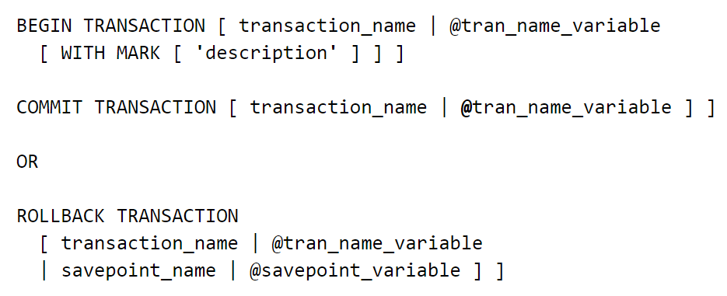
Transaction syntax

Slide 6
Transaction states
A transaction must be in one of the following states:
Active
Partially committed
Failed
Aborted
Committed

Slide 7
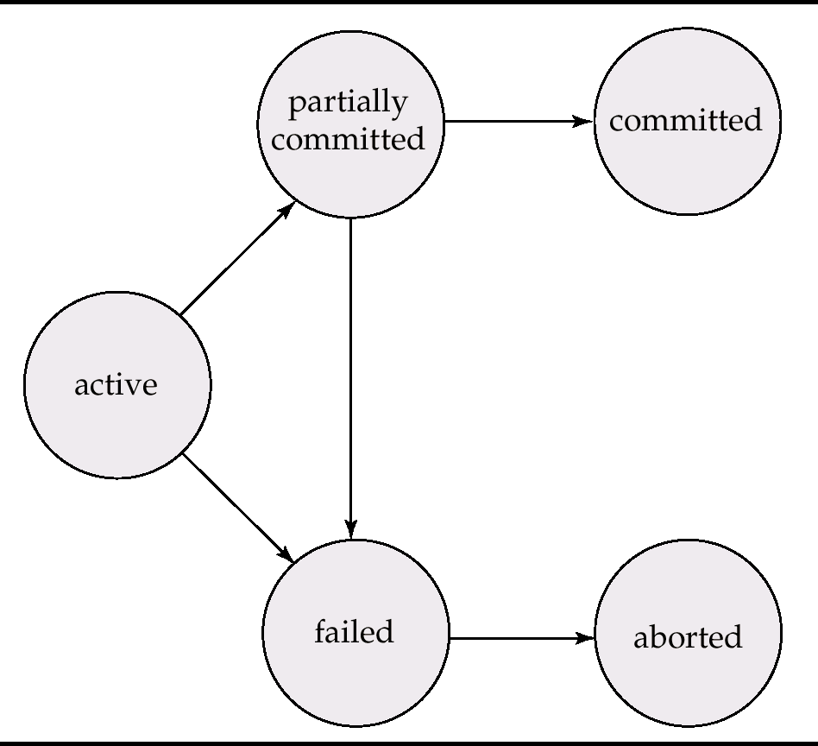
Transaction states

Slide 8
Summary
The transaction is a critical component of the database.
Using when several operations must succeed or fail as a unit.
It have four standard properties and five states.

Slide 9

Thank you for listening !

